Slide 2
About KJU
Kodolanyi Janos University of Applied Sciences (KJU) is a state accredited foundation university offering:
academic programs in the fields of
Tourism & Hospitality,
Business Management,
Mass Media & Communication,
International Relations,
Social Sciences,
History,
Cultural Management,
Jazz Performance,
Foreign Language Studies.

Slide 3
About KJU
Besides the academic programs KJU also offers a wide range of post-secondary, post-graduate and LLP courses for trainers and trainees as well as international semesters, summer courses, study tours and internship programs.

Slide 4
Facts and figures
3500
Number of degrees issued
Medium size- university established in
1993
Current number of enrolled students
22 000
3500
Teacher-student ratio
Number of double degrees issued
Number of degrees issued in Tourism and Hospitality
300
1/15
Number of national and international quality awards
12

Slide 5
International Campus Program
In the field of internationalization KJU is very active with over 260 partnerships in 36 countries all around the globe.
Within the International Campus Program KJU welcomes international students to its degree courses, exchange programs, and project based short courses as well as the double degree programs jointly developed with Kazakh, Russian and Ukrainian universities.
The excellence in management, education, methodology and services and has been acknowledged with several national and international quality awards.
All registered students at KJU are eligible for the ‘Kodolanyi Scholarship’ for excellence and the European mobility grant for international part time studies and internship.

Slide 6
Facts about the Programs in Tourism
KJU was a pioneer in Hungary in launching a degree program in Tourism and Hospitality developed based on the Swiss model
40%
90%
of the professionals in the field of Tourism in Hungary are KJU graduates
of all KJU graduates get employment within 6 months after their graduation 50% of which have executive perspectives in their professional career

Slide 7
Career Opportunities for Graduates
Leadership roles in
Leading employers
Government policy
Environmental management
Research & education
Conference & events management
Tourism marketing
Tourism authorities (international, national, and regional)
Own enterprises
Hotels
Spas
Restaurants
Recreation Centres
Festival/ Conference Centres
Golf Clubs
Tourist Agencies
Ministries/Government Offices

Slide 8
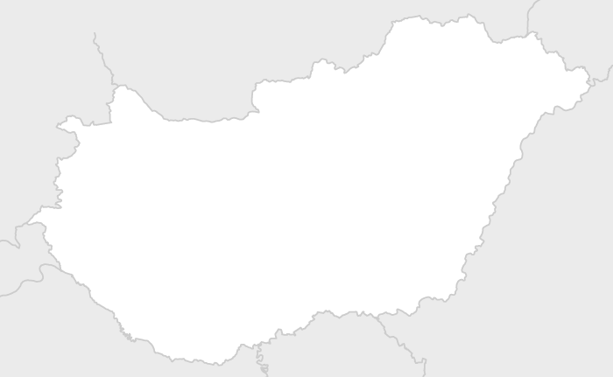
Top Positions of KJU Graduates
Hungary
Director of Operations, WineCreative Ltd. General Manager, Aria Hotel Budapest Director of Sales and Marketing, Buddha-Bar Hotel Budapest Klotild Palace Senior Manager at KPMG Leisure, Travel & Tourism Tour Operator at Prime Travel Agency Group Sales Coordinator, Accor Hotels HR Coordinator, Samsung External Relations Officer, Höpe Ltd. Event Coordinator, Marriott Marketing Executive, Hungarian Golf Federation Sales Manager, The Ritz Carlton Hotel Company Global Transformation Consultant IBM Project Manager, Hewlett Packard Entreprise

Slide 9
Top Positions of KJU Graduates
Spain Business Development Manager, Italian Venture Hotellerie Spa Business Manager, Meliá Hotels International
Germany Business Development Manager, Airbnb Team Leader, Wackler Facility Management GmbH Sales Manager, Berlin Courtyard by Marriott
Sweden Destination and Distribution Manager, ArrivalGuides
UK FIT Customer Service Supervisor, Travco LLP Meeting & Event Sales Executive, glh Hotels At Your Service Manager, Grosvenor House, JW Marriott Spa Coordinator, The House of Elemis
Ireland Front Office service manager, Conrad Hotels & Resorts
Turkey Payroll Administrator for Turkey, IBM Global Services
UAE Cluster Credit Manager, InterContinental Hotels Group Switzerland Compensation Manager Europe Region, Alcoa Europe Sarl Hotel Contracting Manager, AIC Norway Business Development Manager, Future Homes AS Meeting and Conference Coordinator, Sola Strand Hotel Australia Area Manager, Regus Australia

Slide 10
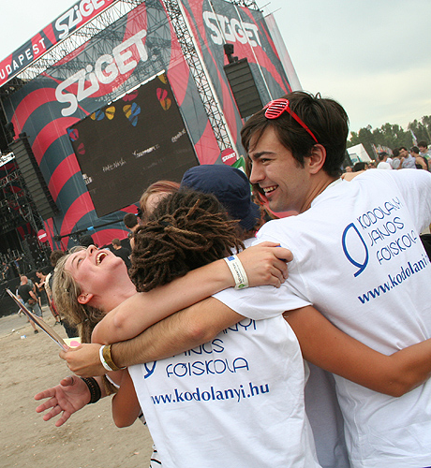
MASTER’S IN TOURISM MANAGEMENT DOUBLE DEGREE PROGRAM
The MSc. in Tourism Management is designed to develop your skills and knowledge in a fast changing, dynamic global industry through problem-based thinking and international orientation.
You’ll have the opportunity to be involved in practical development projects and research activities

Slide 11
KJU’s Added Value Tourism in Hungary
Tourism in Hungary is not only a key economic activity, but its quality-of-life-enhancing role has also been recognised by the government in the National Tourism Strategy, which reflects the country’s far-sighted approach to tourism development.
Due to Hungary’s central geopolitical and cultural position within Europe, it is the perfect place if you want to understand both Western and Eastern European tourism trends, attitudes and motivations, and you want to gain experiences that prepare you to successfully cope with challenges in multicultural environments.
Health tourism, based on a natural wealth of geothermal springs and a mix of old traditions and modern methods, is particularly developed: Hungary is market leader in Europe in the field of dental tourism, and Budapest is undoubtedly the spa capital of Europe, with an abundant supply of health and wellness spas.
Cultural tourism is also well-developed: for example, the Sziget Festival won the Best European Major Festival award in 2011, and the A38 Ship, a popular live music venue, has been voted as the best bar in the world by Lonely Planet readers.
https://www.youtube.com/watch?v=lySnQRmQbiM

Slide 12
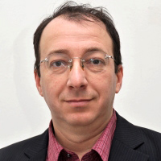
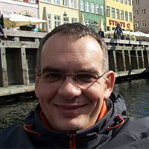
KJU’s Added Value
Institue for Business &Tourism Studies Expertise
With over 20 years of experience in teaching and researching the complex aspects of tourism our professors have worked in various fields in the industry , have collaborated in several national and trans-national projects and are acknowledged memebers of the international professional community.
Dr. habil. Gábor Mihalkó | Dr. Tamara Rátz PhD | Dr. Balázs Füreder PhD
Professor | Director of Institute | Professor
 | https://www.linkedin.com/in/tamara-ratz-42b175a

Slide 13
Structure of Training
4 semesters, 360 teaching hours, 120 credits
Foundation Module: | 30 credit
Professional Core Module: | 32 credit
Differentiated Professional Module: | 37 credit
Elective Module: | 6 credit
Thesis: | 15 credits

Slide 14
Structure of Training
Form of training: part-time blended
The selection of students, admission and enrolment to KJU is done in cooperation with the Partner Institution by KJU staff before the start of the double degree program. The students enrolled, get on the spot training in e-learning methodologies as well as face-to face consultations on subjects offered by KJU.
The total number of lessons defined by the accreditation requirements comprised in the Model Curriculum and Comprehensive Curriculum is divided into:
Contact classes offered by the Partner Institution
Face-to-face KJU consultations at the beginning of the program (on partner’s premises)
On-line KJU consultations
Individual learning

Slide 15
OVERVIEW OF THE PROPOSED DOUBLE DEGREE CURRICULUM OFFERED IN COOPERATION WITH THE PARTNER INSTITUTION
Theory and Methodology of Social and Economic Research in the Tourism Industry URFU | Developing Communications Skills (Oratory) URFU | Entrepreneurship in the Field of Tourism and Hospitality URFU | Computer Technology in the Tourism Industry URFU
Tourism Legislation URFU | Forecasting and Planning the Tourism Activities URFU | MARKETING OF TOURIST DESTINATIONS KJU | Tourist and Recreational Planning Technology and Development of Territories URFU
Theory and Methodology of Recreational Geography URFU | Financial Management of Tourism and Hospitality Business URFU | SUSTAINABLE TOURISM DEVELOPMENT & MANAGEMENT KJU | SOCIOLOGY OF LEISURE KJU
 | Supply management and Logistics of Tourism and Hospitality Enterprises URFU
Modern Strategies of Human Resources Management URFU | SMALL ENTERPRISE DEVELOPMENT& MAMAGEMENT or INTERNATIONAL HOTEL MANAGEMENT (at Partner’s Choice) KJU | ATTRACTION &VISITOR MANAGEMENT KJU | QUALITY MANAGEMENT IN TOURISM KJU
Organizational Project Management URFU | PROJECT MANAGEMENT IN TURISM KJU | Touristic Brand Promotion Technologies of Regions URFU
E-BUSINESS & E-MARKETING KJU |  | Philosophy or Political Science URFU | Workshop: Training, Mentoring, Coaching URFU
TURISM MARKETING & COMMUNICÁCIÓN KJU
 |  | THESIS PROJECT (RESEARCH METHODOLOGY) KJU | THESIS KJU
10+20 credit | 10+20 credit | 20+10 credit | 20+10 credit

Slide 16
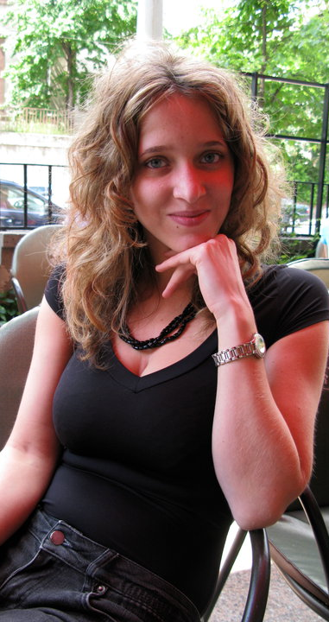
Students about KJU
“Thanks to the research work
I was involved in as well as the professional competitions and student conferences I participated at while studying at KJU, I could continuously improve my academic
writing , scientific thinking and reasoning, important skills that contributed to my
admission to further studies
in the USA.”
(Eva Gellert, Tourism&Hospitality graduate)

Slide 17
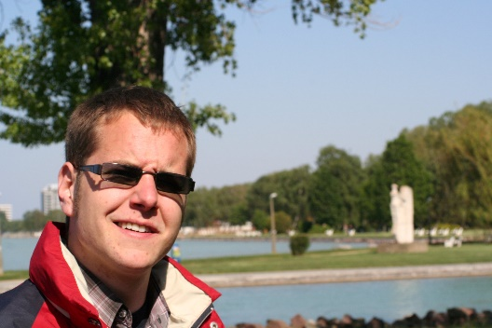
Students about KJU
“KJU – similar to life – is about opportunities. I consider myself a lucky person, because here I was given the chance to put the theoretical knowledge into practice by being appointed to manage the KJU’s study-restaurant.
To my mind, this is a working model that can give you a lot of practical experience.
Besides, I didn’t miss anything from the entertainment and social life offered in a unique atmosphere that has given me inspiration and the feeling of integrity.
I am convinced that by choosing KJU, I have taken a good decision.”
(Akos Dienes, Tourism&Hospitality major student)

Slide 18
Students about KJU
https://www.youtube.com/watch?v=bQJi7x765Uc
https://www.youtube.com/watch?v=GUjYrdJh7gE

Slide 19
For detailed information please contact
Contact
Andrej Ivanyenko
international program manager
andrej@kodolanyi.hu
+36 22 543 377

